Slide 1
Pathogenic free living amoebae
They are small & free-living amoebae, widely distributed throughout the world; in the moist soil, fresh or stagnant water, air-conditioning units & decaying vegetations.
They are considered as facultative parasites accidentally infecting man & causing serious infections.
Two genera are of medical importance:
Genus Naegleria & Genus Acanthamoeba.

Slide 2
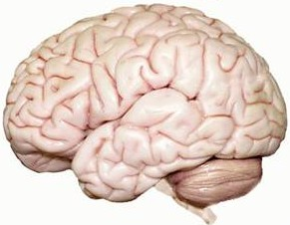
Naegleria fowleri
Disease: Primary amoebic meningoencephalitis [PAM].
Habitat: The brain.
Mode of infection
Infection occurs through the nose during:
1- Swimming in contaminated water.
2- Sniffing contaminated water.
3- Inhalation of contaminated air and dust.

Slide 3
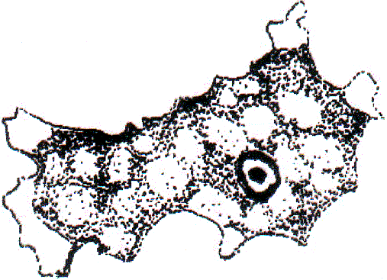
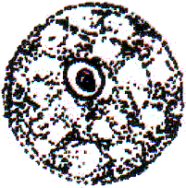
Morphology === 1- Trophozoite a- Amoeboid form (= infective stage): Found in CSF & brain tissues. Rounded or elongate [15- 30 um] & has a big nucleus with a large karyosome but no peripheral chromatin. === b- Flagellate form: Found in culture and water, not in tissues. longated with anterior nucleus & anterior 2 flagella. It transforms back to the amoeboid form within 24 hours.
2- Cyst
It is round [about 10 µm in diameter] with a thick smooth cyst wall & a single nucleus.
Cysts are not seen in clinical specimens because the infection is so rapid, fatal and the patient dies before trophozoites changes to cysts

Slide 4
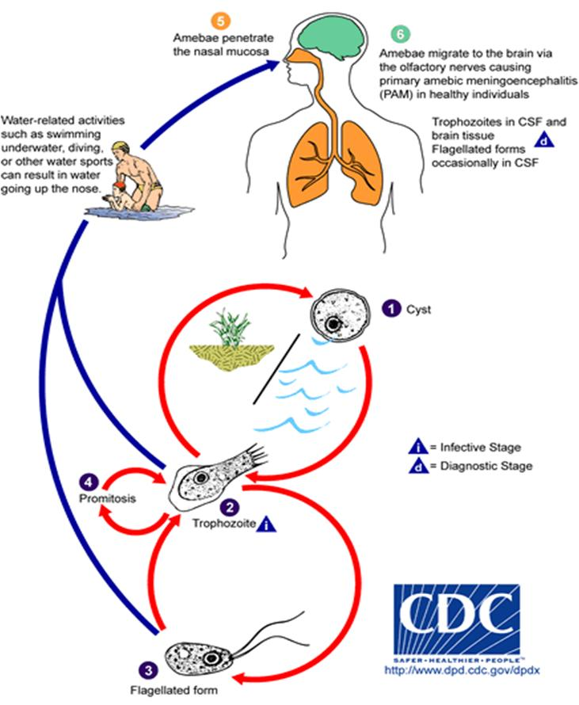
Life cycle

Slide 5
Pathogenesis & clinical picture of PAM [Cont.]
- The course of PAM is dramatic.
- The illness begins 2-7 days after exposure & swimming in fresh water.
- There is fever, rhinitis, pharyngitis, headache followed by nausea, projectile vomiting, stiffness of the neck (meningitis) and convulsions.
- Disturbance in smell or taste may occur.
- The patient enters in coma and death follow within 3-6 days.
(death occurs in more than 95% of cases)

Slide 6
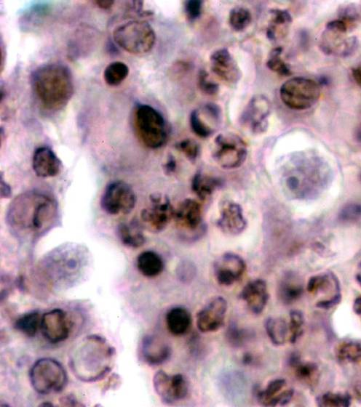
Diagnosis
1-Clinical: History + Clinical manifestations.
==
2- Laboratory: Examination of Cerebro Spinal Fluid (C.S.F.).
C.S.F. is taken by spinal puncture & examined as follows:
a-Macroscopically: It appears cloudy, purulent or bloody.
b-Microscopic examination: shows amoeba forms, leucocytosis (neutrophils) & RBCs, but no bacteria.
c-Chemically: Increased protein and decrease glucose levels.
d-Culture on non-nutrient agar plate seeded with Escherichia coli.
e-Suspension in fresh water shows transformation of amoeboid forms into flagellate forms within 2 hours.
3- Postmortem examination of brain tissues
reveals extensive haemorrhage with amoeboid trophozoites
but not cysts.
Amoeboid trophozoite

Slide 7
Treatment === Amphotericin B is given intravenous. It may also be given intrathecally until CSF is cleared.
Prevention and control
1- Avoidance of swimming or bathing in contaminated water.
2- Proper chlorination of water supply and swimming pools.

Slide 8
Acanthamoeba species
Diseases:
1- Granulomatous amoebic encephalitis (GAE).
2- Acanthamoeba Keratitis (AK).
GAE occurs mostly in immunocompromized persons, whereas
AK affects healthy persons.
Distribution: Worldwide (most of cases from USA).
Habitat: CNS, skin, eye, lung or genitourinary tract.
--
Mode of infection
1- CNS infection is blood borne; it occurs secondary to infection in skin or lower respiratory tract.
2- Blood carries the parasite from the primary lesions to the CNS & may be to other organs as kidney, uterus & pancreas.
Infective stage: Amoeboid trophozoite.

Slide 9
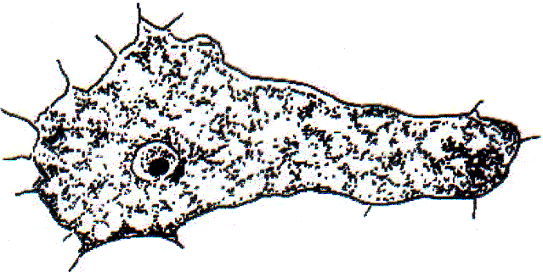
Morphology of Acanthamoeba
1- Amoeboid trophozoite:
[the infective stage]
It is irregular in shape (25 x 30 um) with the long, slender, spine like pseudopodia & a single nucleus.
2- Cyst:
It is round in shape, about 15-20 µm in diameter with irregular wrinkled surface & a single nucleus.

Slide 11
Life cycle of Acanthamoeba species

Slide 12
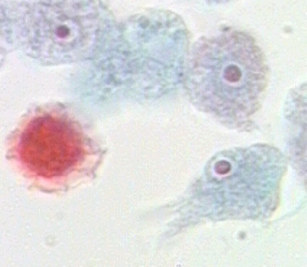
Pathogenesis & clinical picture of GAE
1- GAE is a chronic infection characterized by focal granulomatous lesions in the brain and in other affected organs.
2- The incubation period is not known [few weeks to months or even years].
3- There is change in mental state, headache, convulsions, nausea, vomiting & neck rigidity
4- In Aids patients, the disease may be severe & similar to infection with Naegleria.
Diagnosis of GAE
CSF examination demonstrates trophozoites.
Treatment of GAE
1- Excision of focal lesion + Ketoconazole,
2- Penicillin & chloramphenicol.

Slide 13
Acanthamoeba Keratitis (AK)
===
Mode of infection
AK is caused by direct contact of the cornea with the amoebae, either through
- corneal abrasion,
- exposure to contaminated water or
- wearing contaminated lenses.
-----
==Pathogenesis & clinical picture
AK has a chronic progressive ulcerative keratitis with severe ocular pain &
affection of vision.
AK resists treatment with usual antifungal, antibacterial or antiviral agents &
if it is not successfully treated it may progress to corneal perforation, blindness
& loss of vision.

Slide 14
Diagnosis === Microscopic examination of corneal scraping (directly or after culture): demonstrates both trophozoites & cysts. Treatment === 1- Topical miconazole. 2- Corneal transplant for keratitis.
Prevention & control
1- The preventive measures to control GAE are difficult as the amoebae are present in air, soil and water.
2- AK caused by the use of contact lens can be prevented by:
a- Proper cleaning & disinfecting the lenses.
b- No wearing lenses while swimming.

Slide 15
Naegleria
Meningoencephalitis
Acanthamoeba
Encephalitis
Mainly in Debilitated, chronically ill with low immunity
Mainly in Children & young adults
Lesion: Diffuse meningoencephalitis.
Runs rapidly fatal course
(death within 3-6 days)
History of swimming in natural water or swimming pools.
Infection occurs through:
The nasal route → cribriform plate
→ olfactory nerve → brain.
Lesion: Focal, granulomatous,
space-occupying lesion.
Runs sub-acute or chronic course
(lasts for weeks, months or years)
Not strongly associated with
swimming.
Infection occurs in:
Lower respiratory tract, ulcerated skin
or mucosa → blood stream → CNS

Slide 16
Life cycle of Pathogenic free living amoebae

Slide 17
Cysticercosis
Definition: It is a pathological condition results from invasion of human tissues by cysticercus cellulosae, the larval stage of Taenia solium.
Man acts as a blind intermediate host.
Mode of infection
Ingestion of eggs of T. solium by one of the following ways:
1- Ingestion of food or drink contaminated by infected human faeces.
2- Autoinfection occurs in a patient having adult worm in his intestine:
a) External autoinfection: Hand to mouth infection or
b) Internal autoinfection : Segments are regurgitated into the stomach by reverse peristalsis, disintegrate & liberate eggs.
In the small intestine, eggs hatch & liberate onchospheres that penetrate intestinal mucosa to the circulation > to varies parts of the body where they develop into cysticercus cellulosae.

Slide 18
Pathogenesis & clinical picture
Most human cysticercosis occurs in CNS , in eye, in liver, muscles and subcutaneous tissue. Cysts produce inflammatory reactions ending in fibrosis and calcification.
Clinically:
1- Most cases are asymptomatic.
2-Heavy infection in muscles may cause myositis, fever and eosinophilia.
3- Ocular cysticercosis occurs in the orbit or in eye chambers or the retina. This has sudden visual disturbances or retinal detachment.
4- Neuro cysticercosis: There is epilepsy, headache & other signs and symptoms according to the site of cesticerci.

Slide 19
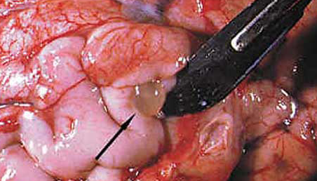
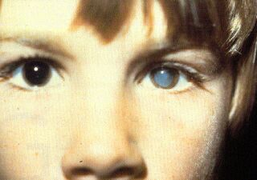
Cysticercus cellulosae
In human brain
In anterior chamber of left eye

Slide 20
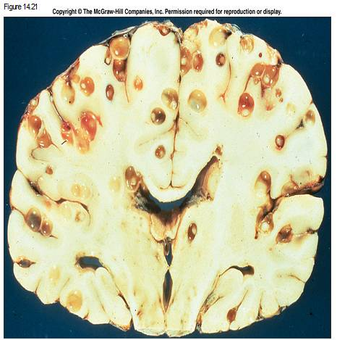
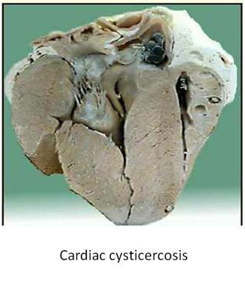
Cysticerci in human tissues
Cerebral cysticercosi
Cardiac cysticercosis

Slide 21
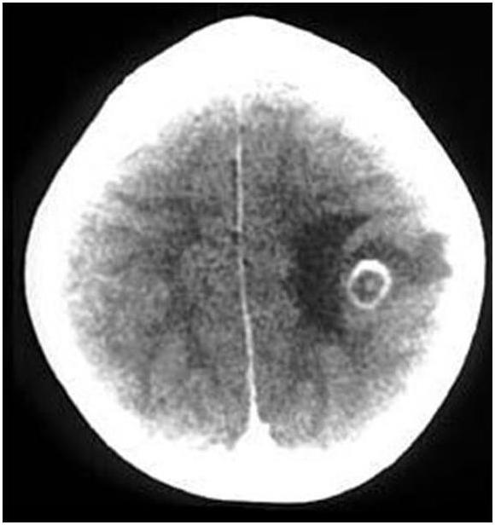
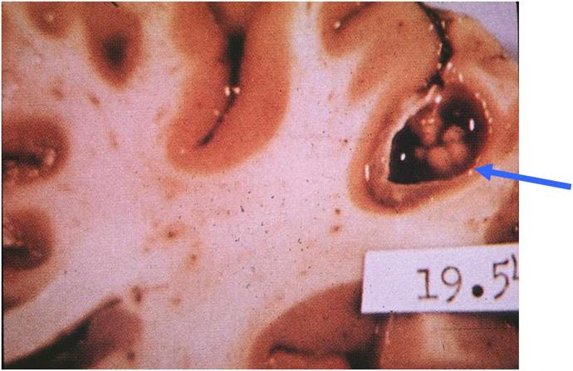
Cerebral cysticercosi

Slide 22
Diagnosis
1- History of harboring adult worms is suggestive.
2- Clinical picture differs according to the site of infection.
3- Eosinophilia.
4- Serological tests as IHA & ELISA.
5- Radiological methods:
* Plain X-ray may show calcified cysts in brain.
* Ocular cysts can be seen by slit lamp examination.
* CT and MRI can show calcified & non calcified brain cysts and spinal cord cysts.
6- Biopsy from operable nodule [in the skin or muscles].

Slide 23
Treatment
1- Surgical removal.
2- Praziquantel: 50 mg/kg/day in 3 divided dose for 15 days.
3- Abendazole:15 mg/kg for 10-30 days
4- Corticosteroids.
5- Vitamin D & calcium.
Prevention & control
1- Avoid eating improperly washed vegetables.
2- Patient with adult parasite should be treated.
3- Infected persons should not take nauseating drugs.
4- Pure water supply & sanitary disposal of human excreta.

